Slide 1
Digital Services
Formal and semi-formal approaches to the design of high-reliability and trustable information system services
Molnár, Bálint

Slide 2
Application opportunities
Possible applications of research results in applied (industrial) research:
  Database schema mapping to a research-supporting, international, industry standard database schema
  Migrating data, mapping textual attribute values, using computational intelligence natural language processing methods.
  Organisational/institutional information systems (corporate, financial):
    Checking the correctness, appropriateness, consistency and integrity of dynamically changing, altered processes
  Developing patterns for the application of blockchain technology in information systems workflows, processing cases, developing program generation algorithm(s) from models.
    Examining the transparency, interpretability and understandability of data analytics algorithms integrated as a service into workflows. Developing support in process specification, using patterns to make decisions transparent and understandable to end users.

Slide 3
Data Science for Finance: Best-Suited Methods and Enterprise Architectures
Overview article
Processing case studies
Preparing further work
Introduction to the topic for Ph.D. and MS.C. students

Slide 4

[1]
G. Pisoni, B. Molnár, and Á. Tarcsi, “Data science for finance: best-suited methods and enterprise architectures,” Applied System Innovation, vol. 4, no. 3, Art. no. 3, Sep. 2021, doi: 10.3390/asi4030069.

Slide 5
Model to Program and Block-chain approaches for Business Processes and Workflows
Meriem Kherbouche, Galena Pisoni, Bálint Molnár

Slide 6
Summary
We investigate the utilization of Block-chain technology for model checking of Workflows, Business Processes to ensure consistency, integrity and security in dynamically changing business environment.
We transform the block-chain to UML activity diagram followed by a verification using petri nets to guarantee a distributed computing system and scalable with mutable data.

Slide 7
UML profile for blockchain
We propose to create a structured UML profile, a new meta-model, to lightweight extend the UML meta-model by adding the block-chain part to the Activity diagram.
Profiles allow adaptation of the UML meta-model for platforms like Java platform, .NET Framework, etc... or domains such as our case business process modelling, insurance, medical applications, service-oriented architecture, etc.

Slide 8
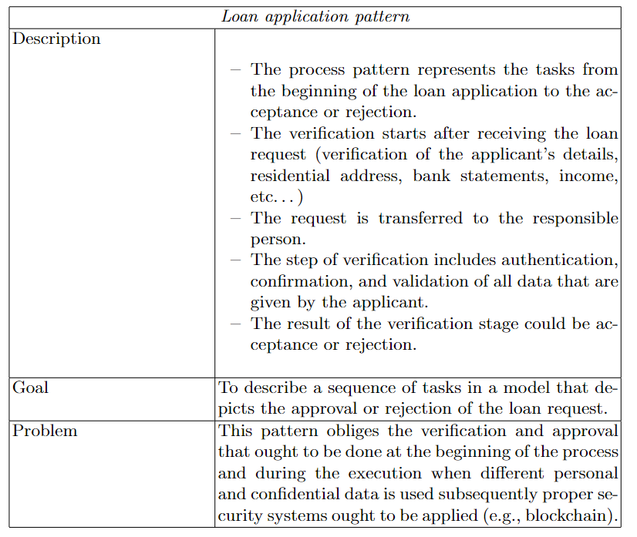
Blockchain-based business process management (BPM) for finance: the case of loan-application

Slide 9
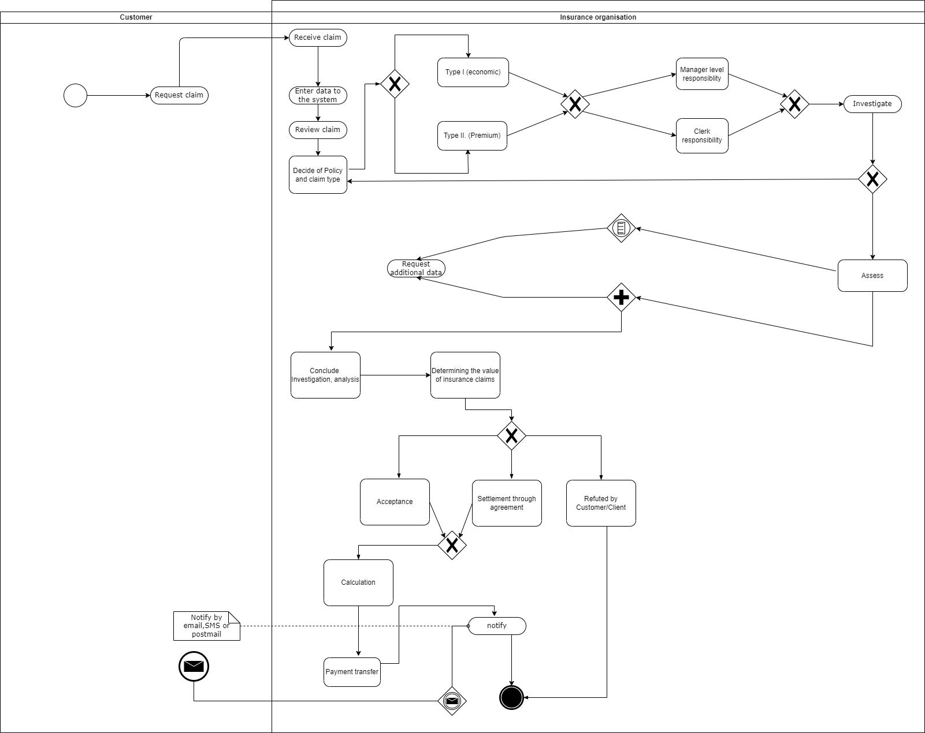
Insurance claim- Activity diagram

Slide 10
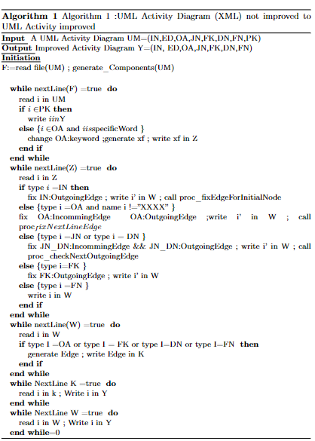
The algorithm of improvement

Slide 11
Conclusion and future work
We discusses the power of modelling business processes using UML activity diagrams and model transformation M2P benefits from the strength of block-chain and UML profiles to facilitate insurance claims. Where, a UML profile was created to extend the UML activity diagram by adding a part that represent block-chain. Then we Transformed the whole extended diagram to Petri nets by respecting the generated rules of transformation.
Block-chain integration in the insurance field can be a promising multi-actor research area.

Slide 12
Conclusion and future work
The application of block-chain technology can be perceived as web services or micro-services that are called by tasks of specific Business Processes.
The patterns of Business Processes and web services initiate the review of workflow patterns. The workflow patterns are elementary building blocks that can be either extended or expanded by necessary constituents to take into account the specialty of Business Processes in Financial Services Technologies and the application of block-chain technologies.

Slide 13
Knowledge-enriched schema matching and mapping
Chuangtao Ma, Bálint Molnár, Ádam Tásci

Slide 14

Introduction
Semantic heterogeneity in various schemas brings some obstacles while establishing the correspondences between source schema and target schema.
The performance of the matching algorithms depends on the characteristics of the datasets such as abbreviations, acronyms, synonyms, and combined words and combined words.
The human interventions and knowledge from domain experts are required to tackle the above complex mapping task.
Research Questions:
How to analyze, parse, and represent the database schema at instance level and attribute level
How to enrich and augment the schema matching by using external knowledge bases?

Slide 15
Proposed Framework
The schema matching network is designed based on knowledge injection as a classifier to identify the mappings.
The framework of knowledge-enriched schema matching
2022.05.24.
15

Slide 16
Proposed Framework
Knowledge Embeddings: the related knowledge bases are selected and mapped into continuous vector space by leveraging the representation learning to provide the knowledge for the enrichment.
Knowledge Representation Learning and Knowledge Embeddings
2022.05.24.
16

Slide 17
Proposed Framework
The pre-trained word embeddings, GloVe, ELMo, will be utilized to obtain the initial vector representation of the textual description.
The trained representation of the textual description of entity and are concatenated with the trained KBs embeddings by injecting the external knowledge.
The generated new vector representation that is fed into the schema matching network as the input sequence to train a classifier.
Knowledge Enriched Schema Matching
2022.05.24.
17

Slide 18
Preliminary Results
We ran the baseline models, Infersent and Smat, on our self-build EMED dataset. Th results show that the baseline models can converge in a short training epoch.
Meanwhile, it shows that there is potential research gap to improve the F1 value by injecting external knowledge.
2022.05.24.
18

Slide 19
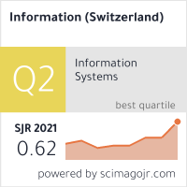
Publikációk
[1] Chuangtao, Ma and Bálint, Molnár and Ádám, Tarcsi and András, Benczúr, Knowledge Enriched Schema Matching Framework for Heterogeneous Data Integration, 2022 IEEE 2nd Conference on Information Technology and Data Science, CITDS 2022, 2022
[2] C. Ma and B. Molnár, “Ontology Learning from Relational Database: Opportunities for Semantic Information Integration,” Vietnam Journal of Computer Science, 2022, 9(1), pp. 31-57. doi: 10.1142/s219688882150024x.
[3] C. Ma, B. Molnár, and A. Benczúr, “A Semi-automatic Semantic Consistency Checking Method for Learning Ontology from Relational Database,” Information, p. 2021, 2021. Journal Rank: CiteScore - Q2 (Information Systems)

Slide 20
Hypergraph Application on BP Performance
Khawla Bouafia , Bálint Molnár.

Slide 21
Introduction
The modeling of graphical representation of Business Processes (BP) or workflows in Enterprise Information Systems (IS) is often to represent the various activities, entities, relations, functions, and how to communicate between them in an enterprise to get the major goal of the operational support.
In this work, we decided to use graph representation approaches, especially hypergraphs to depict the complex relationships that exist among the artifacts and constituents of BP. for more efficient and accurate manipulations.

Slide 22
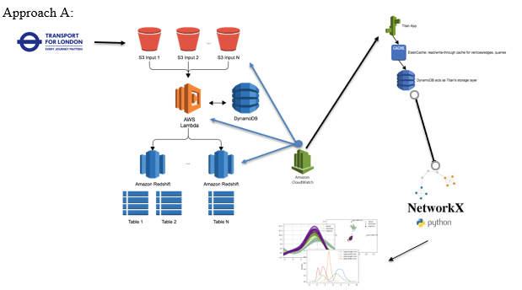
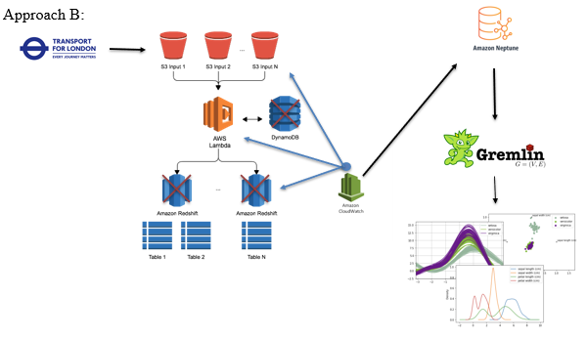
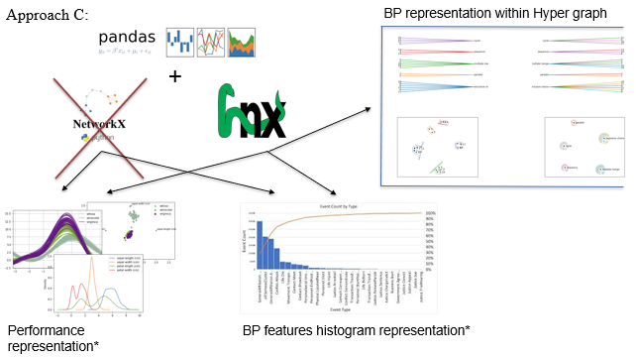
Approaches of BP
We have experimented with different combinations of tools and manually generated data which represents Business Process
We tried different ways of defining BP and on generating simulated data.

Slide 23

Publications
[1]K. Bouafia and B. Molnár, “Hypergraph Application on Dynamic Aspect of Business Process Performance Analysis,” MDPI Information, vol. 12, no. 9, Art. no. 9, Sep. 2021, doi: 10.3390/info12090370. (CiteScore - Q2 (Information Systems)
Journal Rank: CiteScore - Q2 (Electrical and Electronic Engineering)
Doktori dolgozat megvédése, január 28.

Slide 24
Cognitive Information Systems and Intelligent Data Analysis Tools
Putnoki, Attila márton
Molnár, bálint

Slide 25
Human-Computer Interaction (HCI), Data Analytics and Cognitive Information Systems
The goal is to prepare an AI and Business Intelligence (BI) supported system to better support or replace business Decision-Making (DM) with automated intelligent bots through Intelligent Process Automation (IPA), which is also linked to Computer Vision (CV), Cognitive Automation (CA), Machine Learning (ML) and Robotic Process Automation (RPA) technologies. To overcome these challenges, multidisciplinary research is needed that bridges different disciplines where process theory and systems theory approach DM, information processing, resonance adaptation and Carbon-Silicon agent modelling in Human-Computer Interaction (HCI) to provide a proven baseline model for future research. The need for this research is also supported by the fact that business decision makers face challenges that they cannot solve in the time available without Cognitive Information Systems (CIS). Translated with www.DeepL.com/Translator (free version)
By laying the foundations of CIS, a system can be developed that better supports the decisions of business actors and managers, optimising their potential decision outcomes.

Slide 26
D. Mattyasovszky-Philipp, A. M. Putnoki, and B. Molnár, “The Unrepeatable Human Mind—Challenges in the Development of Cognitive Information Systems—What Makes a Machine Human?,” Electronics, vol. 11, Art. no. 3, Jan. 2022, doi: 10.3390/electronics11030394.
          Journal Rank: CiteScore - Q2 (Electrical and Electronic Engineering)

Slide 27


The use of hypergraphs in modelling information systems
Application of Directed Hypergraphs for analysis of Models of Information Systems
B. Molnár, A. Benczúr, “Application of Directed Hypergraphs for analysis of Models of InformationSystems,” Mathematics, 2022.
          Journal Rank: JCR - Q1 (Mathematics) / CiteScore - Q1 (General Mathematics)

Slide 28
Facet of an Information System

Slide 29
Documents, workflow and activities

Slide 30
Coding into directed hypergraph

Slide 31
Backward and forward directed hypergraph

Slide 32
Practical Application – Digital Virtual TWIN –to check compliance

Slide 33

Thank you for your attention
……Questions?

