Slide 1

Human-Centered AI: Components and applications
Lőrincz András
Neural Information processing group
Department of artificial Intelligence
ELTE Institute of Industry-Academia Innovation
Notes:
Új lehetőségek nyíltak az ember-gép együttműködésben.
Ezen dolgozik a neurális információfeldolgozási csoport
Engem Faragó Kingának hívnak, én fogom előadni mi történ és mi történik

Slide 2
Content
Intro: Composite AI
NIPG – Human-machine collaboration: tools and applications
  Components
  Components under development
  Studies on complex interactions
  Faculty of Natural Sciences: Robustness against adversarial attacks
Publications 2021-2022
Notes:
Először az új fejezetről lesz szó. Utána betekintünk a kifejlesztett és használt eszközökbe, valamint az alkalmazásokba.
Ezt követi az együttműködések listája és a következtetéseink
Több ipari és EU-s projektünk van. Azon eredményeket, amelyekben volt szerepe a Kiválósági Projektnek halványzöld a színük.
Ha az Európai Unió kiemelt projektjének, a HumanE-AI-nak is volt benne szerepe, akkor halványokker a szín

Slide 3
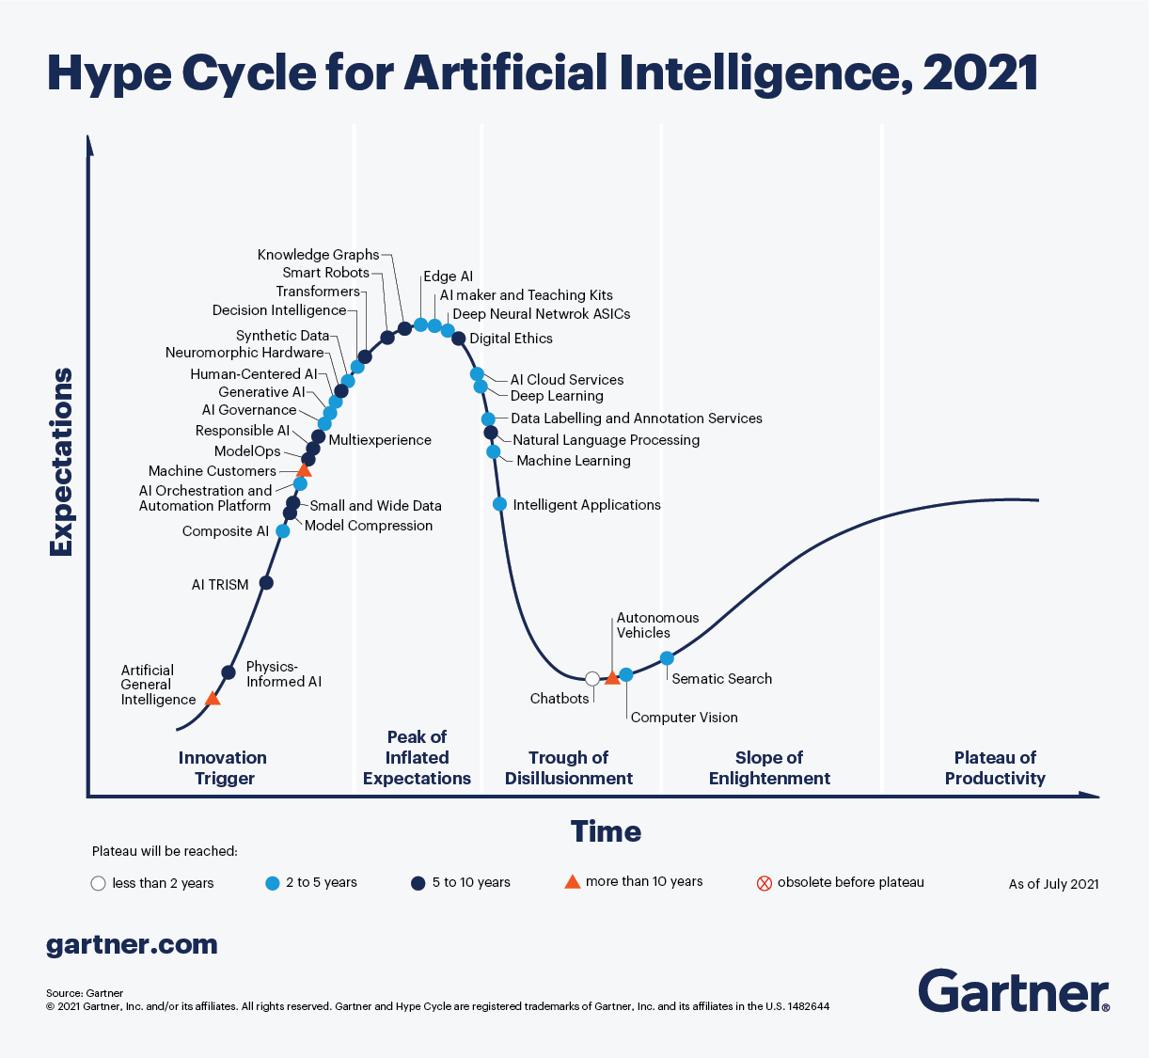
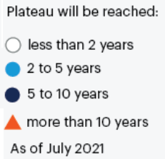
Gartner’s Hype curve helps in finding your job
AI Trust Risk & Security Management

Slide 4
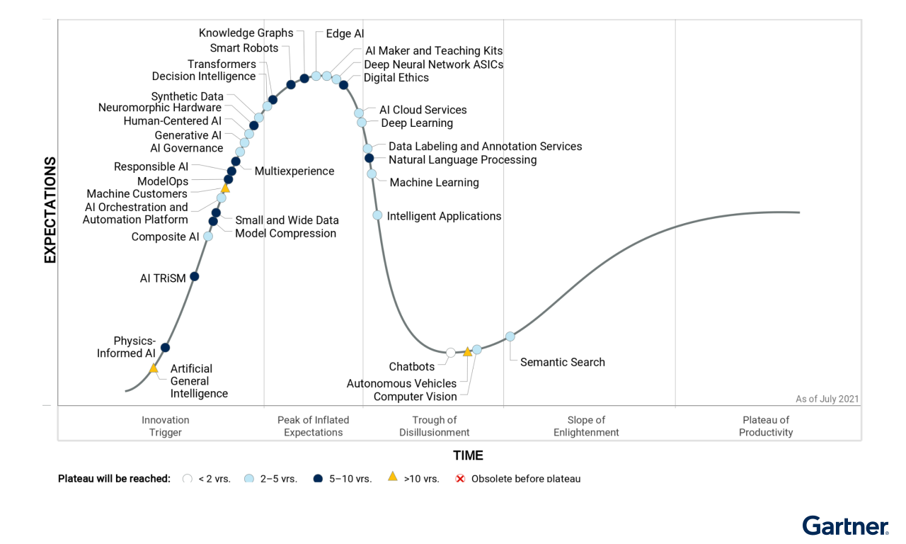
Gartner Görbe
Composite AI is getting hyped
Human-Centered AI is hyped
Intelligent Applications is going down
Deep learning and ML are going down, too…
BUT, products are expected in 2-5 years for all of them
They are all needed for Human-Machine (Robot) collaboration

Slide 5
Common HCAI components and tools
Italic: we are working with them
Body part detection and estimation
  full body, head, hand, object in hand←→manipulation, eyes, gaze←→intention
Behavior estimation
  emotion and personality-state estimation
Environment modeling
  object recognition, semantic/instance maps and matching
Software tools
  tracking, information fusion, deep neural networks and GOFAI←→Composite AI, DNNs being robust against adversarial attacks
Hardware tools
  cameras, camera++ (heart rate, blood pressure), microphone, directed microphone, smart watch (heart rate, stress level)

Slide 6
Gartner

Slide 7
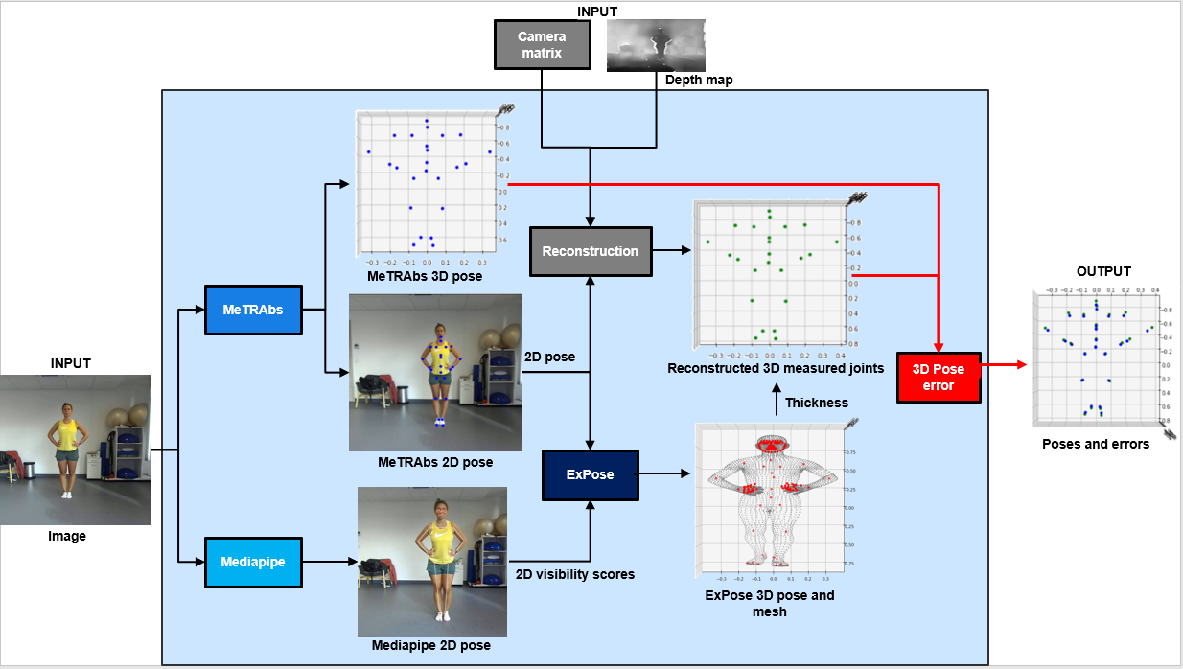
Human body
– Physical rehabilitation
Precise pose estimation and error minimization
  with 2D cameras
  for distant monitoring
  rich set of application possibilities
(b)
(c)
(f)
(a)
(g)
(d)
(e)

Slide 8
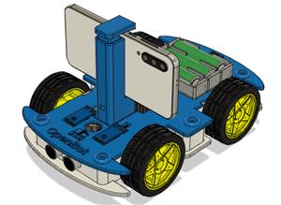
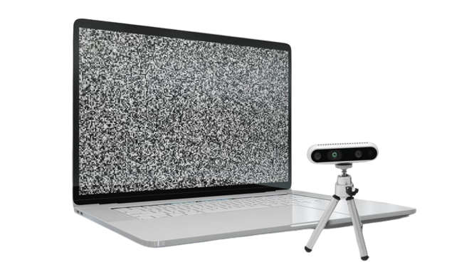
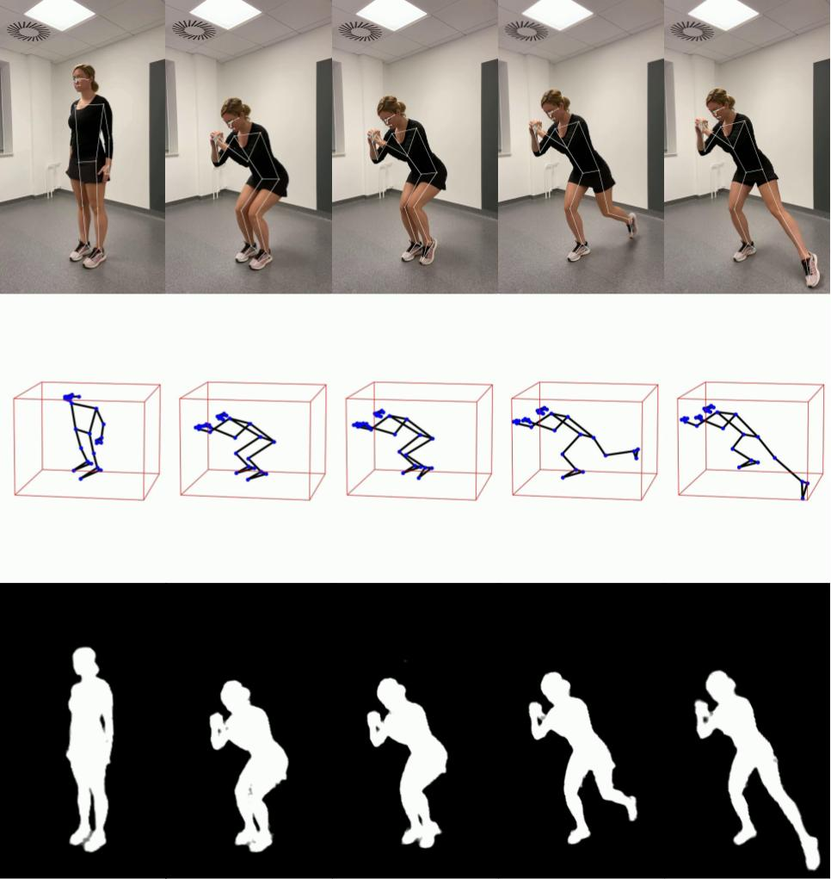
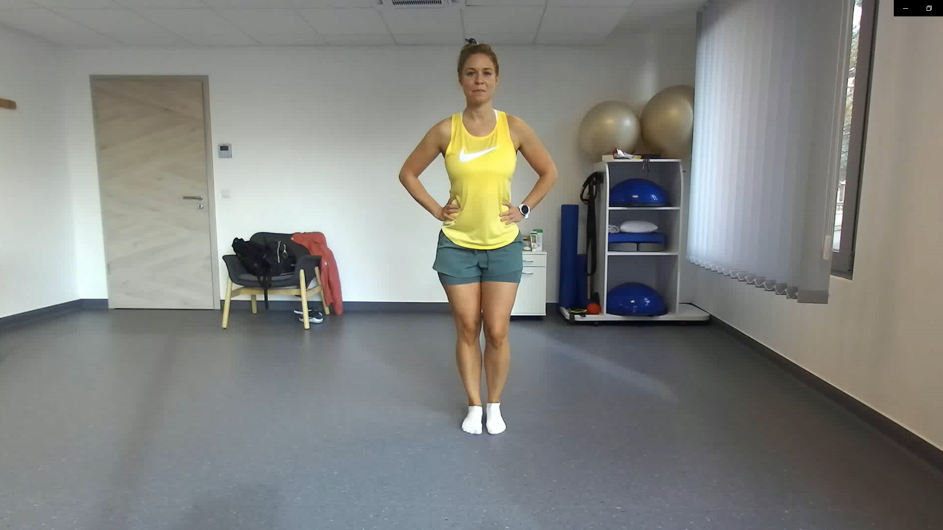
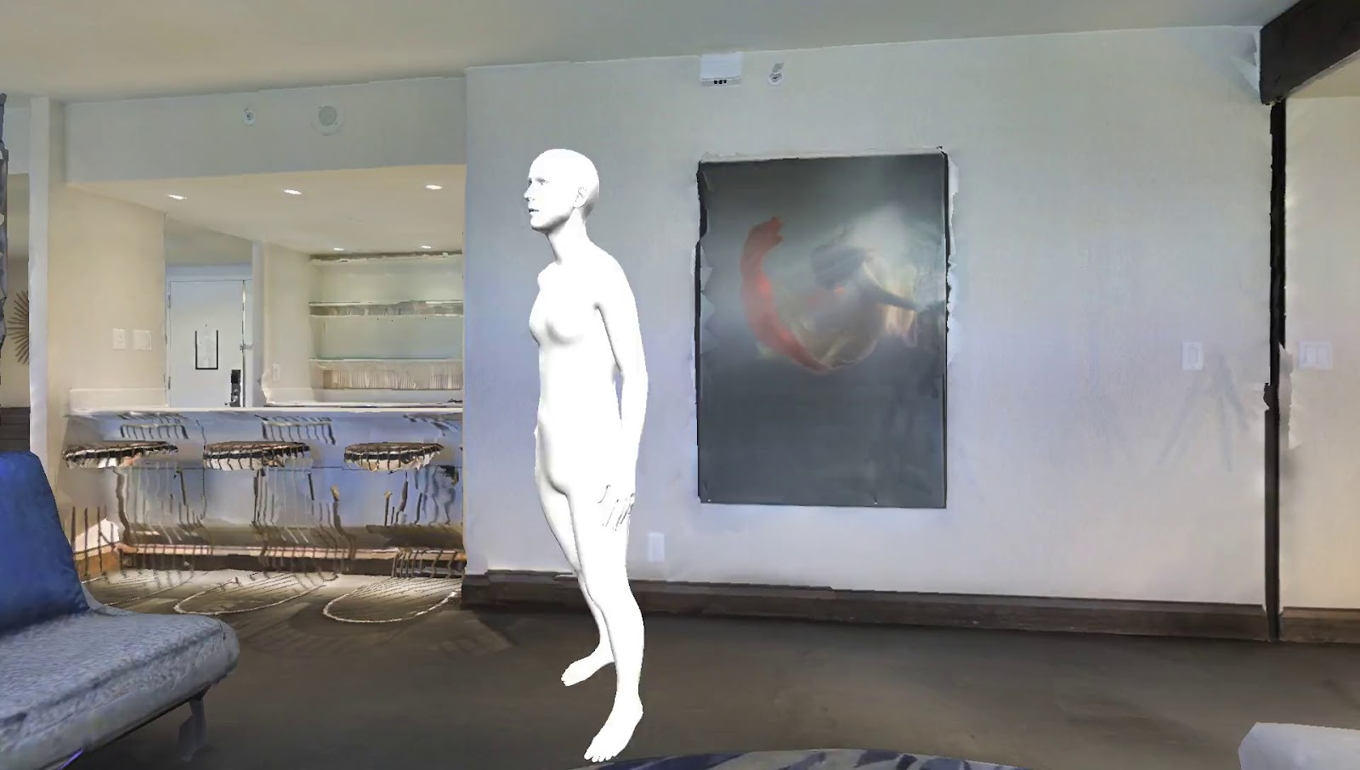
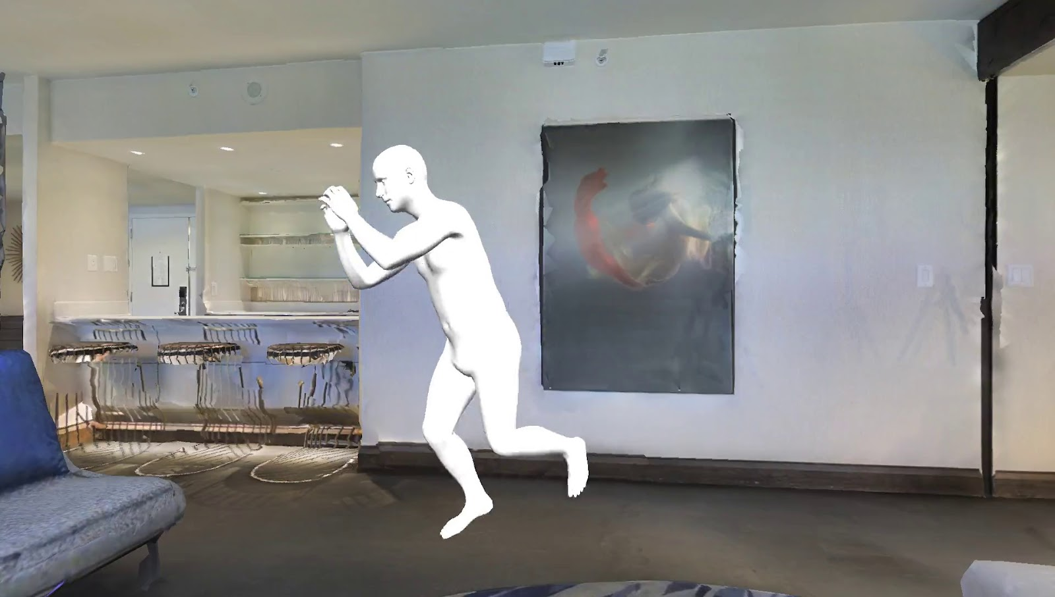
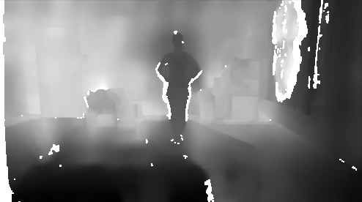
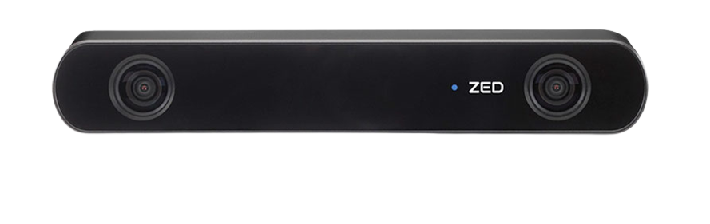
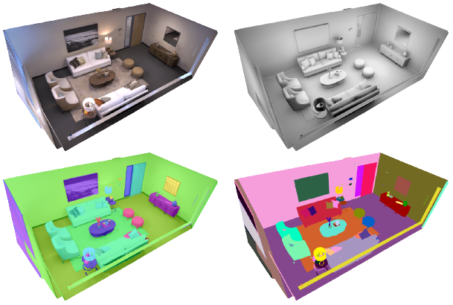
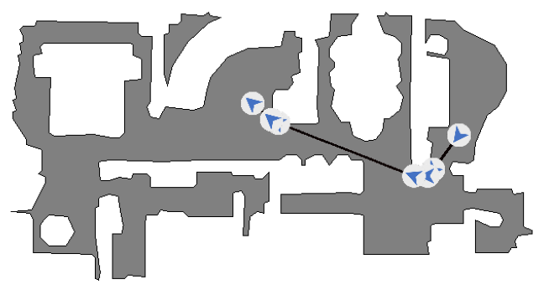
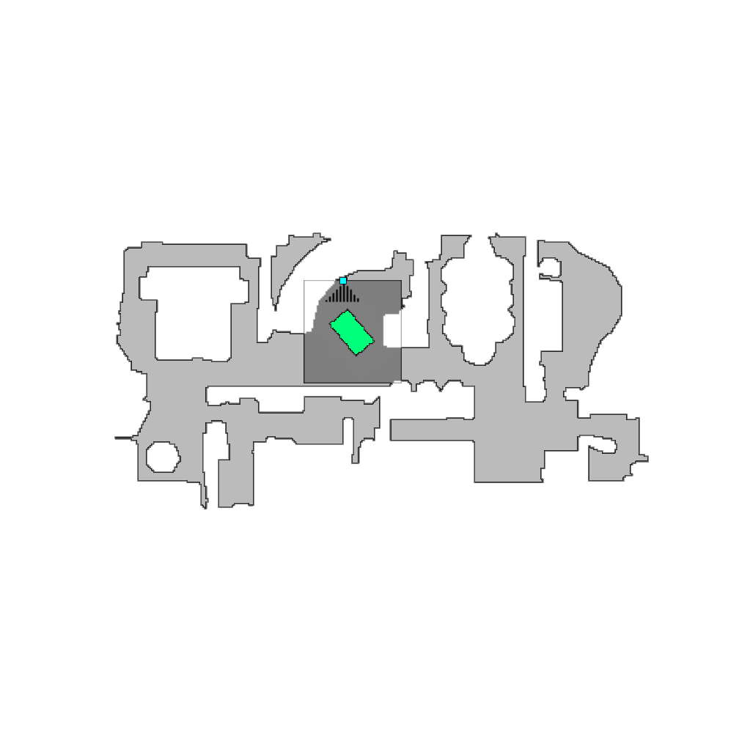
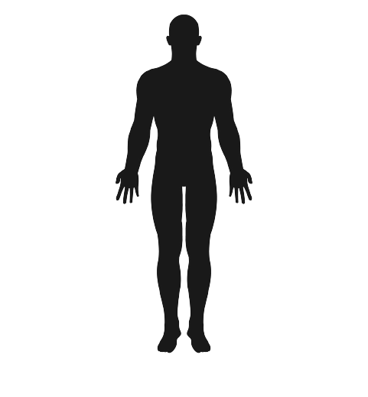
Physical rehabilitation:
Needs beyond body pose estimation
Optimization of position (camera and patient) & help in navigation
Avatar-based demonstration and anonymization for data collection
(a)
OpenBot Laptop
(f)
Machine
Execution
Requires
Communication
(e)
Human: Request for instructions
Robot: Step 1. Turn to the extreme left and walk in the direction of the door
Robot: Visual detection of the execution
Robot: Now, cross the door, turn to the right and make two steps forward
Baranyi, G; Melício, B.C.D.S.; Hajder, L.; Simonyi, A.; Skaf, J.; Dušek, O.; Nekvinda, T., and Lőrincz, A. "Composite AI Technologies for Machine Supervision and Help in a Rehabilitation Scenario" submitted
Video frame
(b)
Evaluation
Zed2 RGB-D camera
Depth map
(c)
Initial State
(d)
Semantic map
Requests
Goal
(Intention)
Planning
Human partner

Slide 9
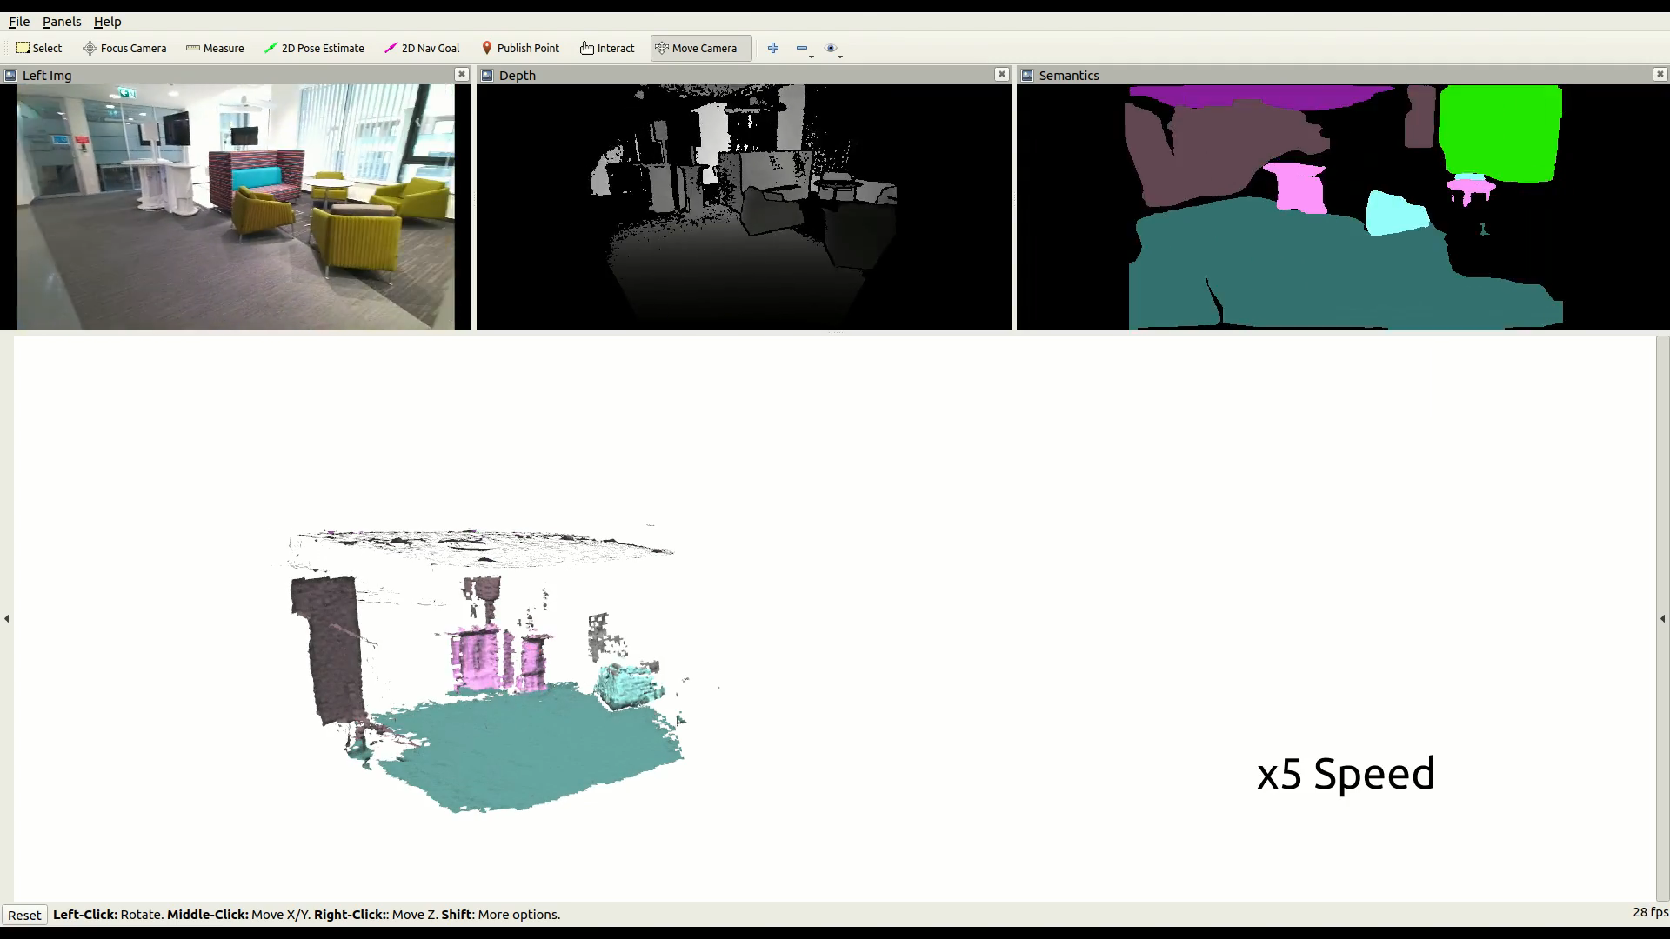
Semantic Map
Movie Depth Semantics
Rozenberszki, Dávid, Gábor Sörös, Szilvia Szeier, and András Lőrincz. "3D Semantic Label Transfer in Human-Robot Collaboration." In Proceedings of the IEEE/CVF International Conference on Computer Vision, pp. 2602-2611. 2021.

Slide 10
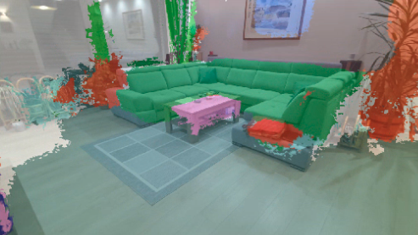
Semantic Map
Corollary: Robot can talk about objects and directions in the patients’s ego-centric coordinate system

Slide 11
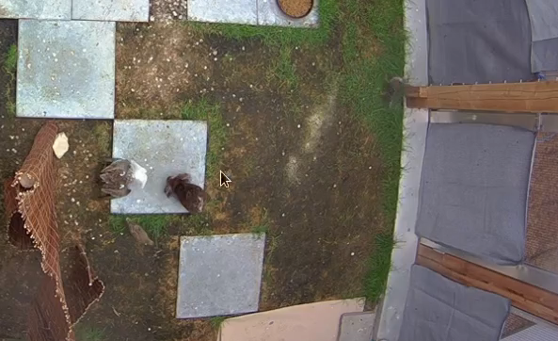
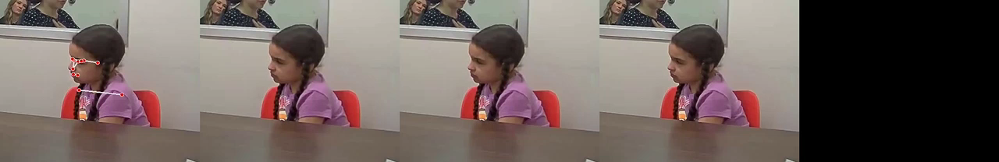
Facilitating data collection:
An application of Composite AI
Image and video processing
Applications
health
environment protection, ethology, genetic studies
  Rush Medical School, Chicago
  Max-Planck Inst for Ornithology, Munich
  Ethology Dept, ELTE

Slide 12
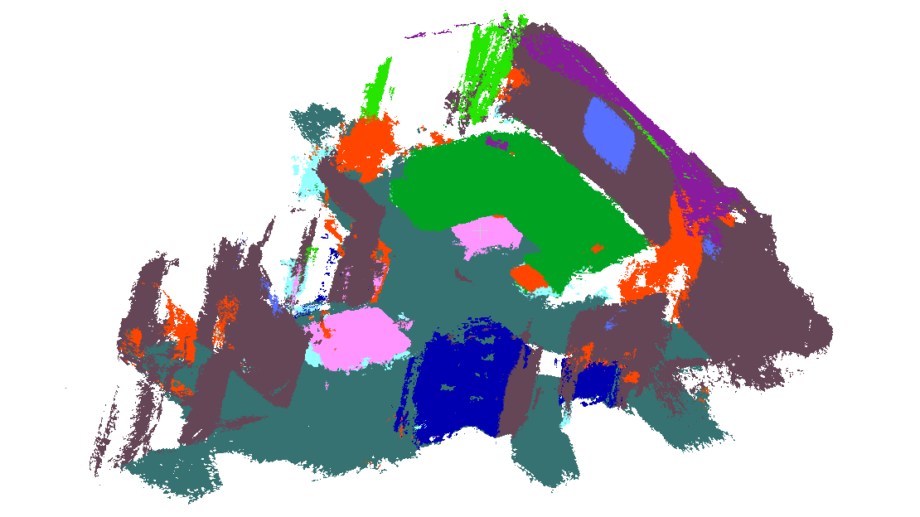
Szemantikus térkép
Corollary: Robot can talk about objects and directions in the patients’s ego-centric coordinate system
If machine can estimate the pose than it can help in navigation and error explication

Slide 13
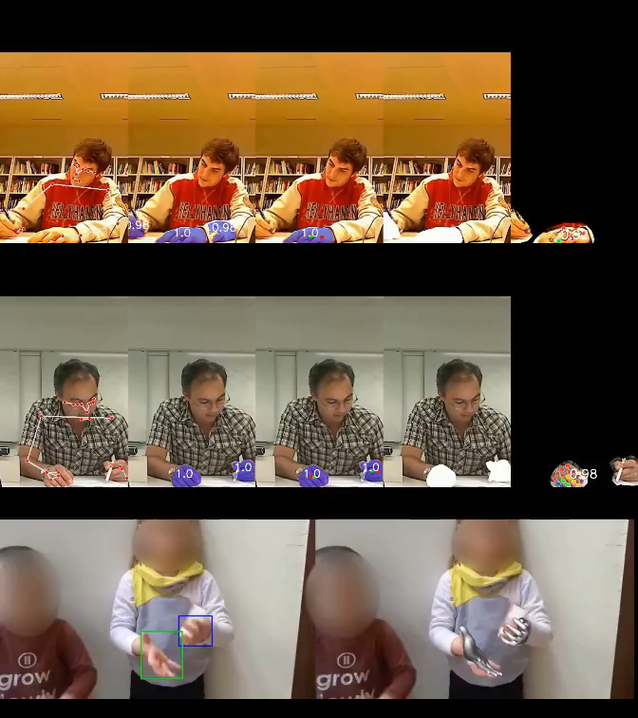
Behavior and personality
What is s/he doing?
What is her/his mood?
What is s/he up to?
Is help needed?
How could the machine help?
Interesting and relevant finding for the avatar technology:
We can talk about
„perceived group-personality-state”
→ Next slide

Slide 14
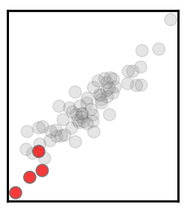
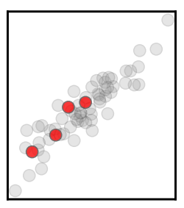
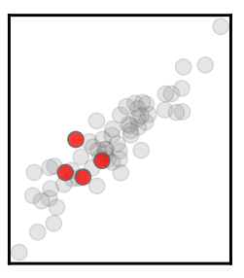
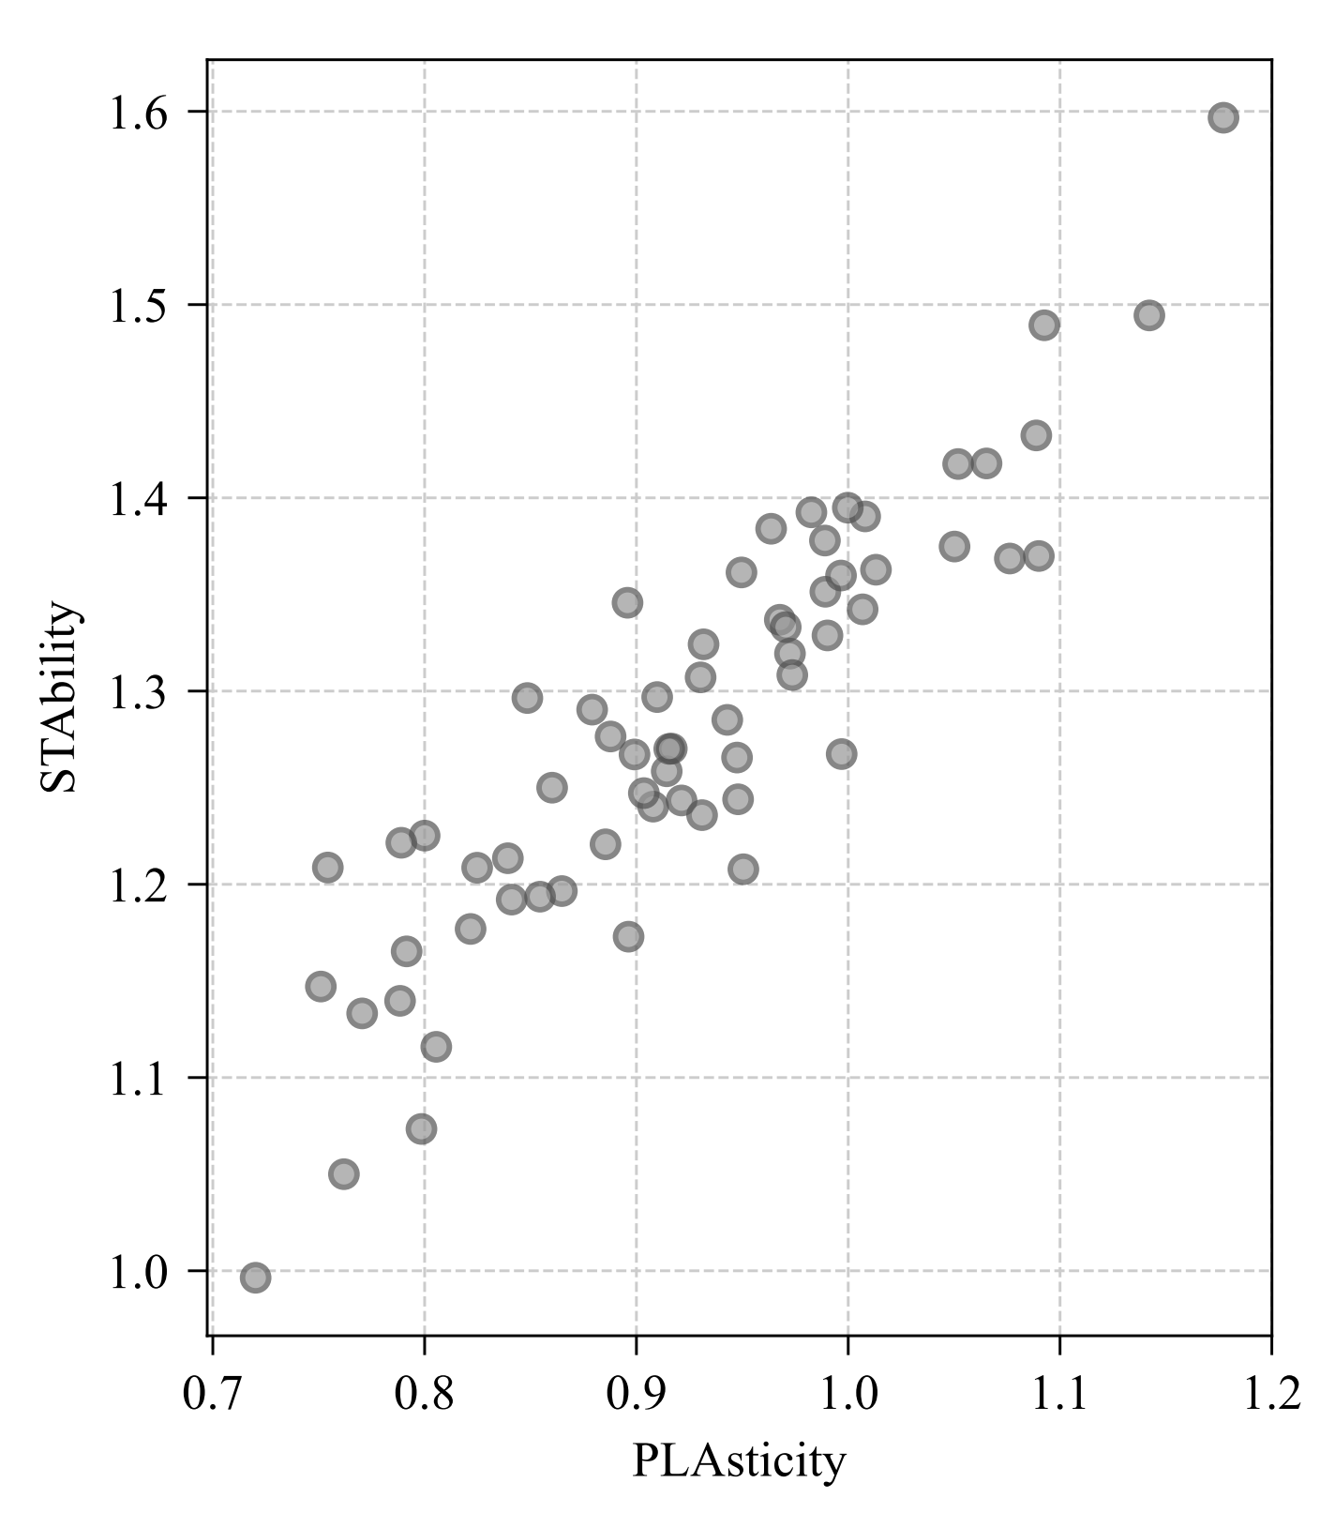
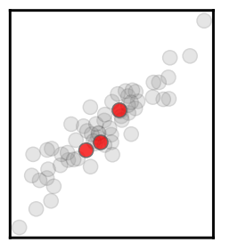
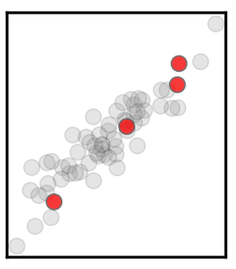
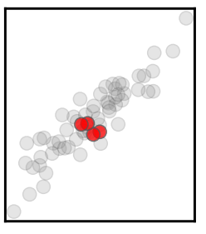
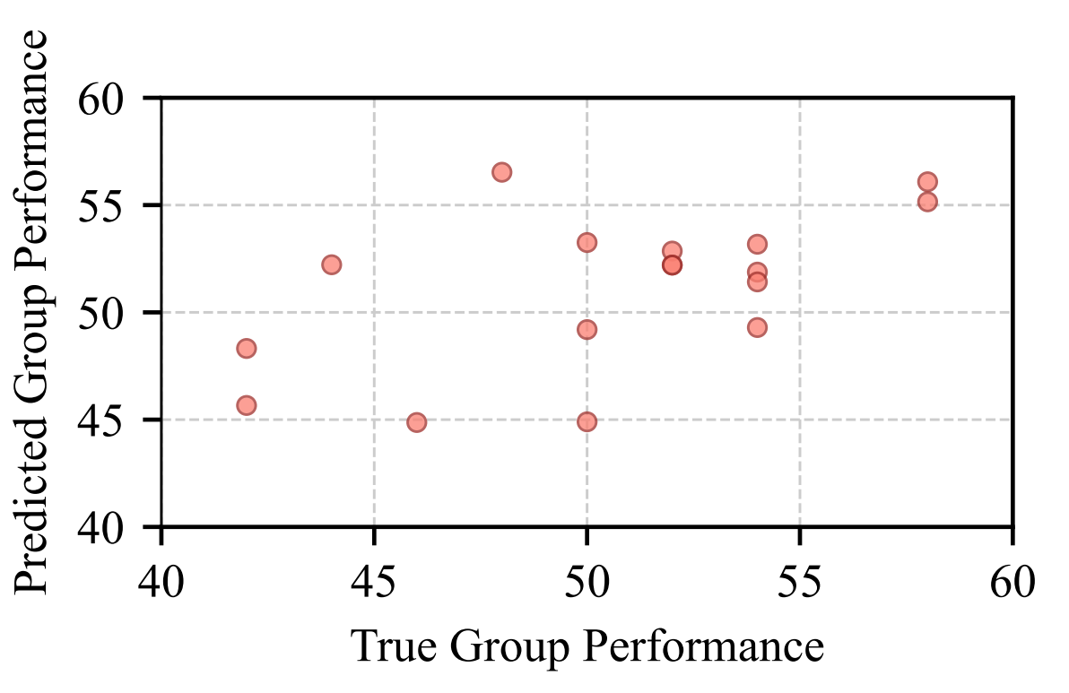
Perceived group personality-state
People tend to have similar perceived personality in groups
Perceived personality of groups can be very different
Personality has predictive power, e.g., on performance
Potential applications in treatments: avatar+patient make a group

Slide 15
Application opportunities
„Continuous healthcare”
  Examples: PTSD, depression, autism, dementia, obesity
„Security of home, shops, banks, and public spaces”
  Examples: manipulation, motion pattern recognition, group behavior detection, biometry, anonymization.
  ⇒ Need for robustness against adversarial attacks
Edutainment, early talent and special need discovery.
Cyber-Physical Systems with human-in-the-loop
  Potential example: extension of the KFI MOBOT warehouse project

Slide 16
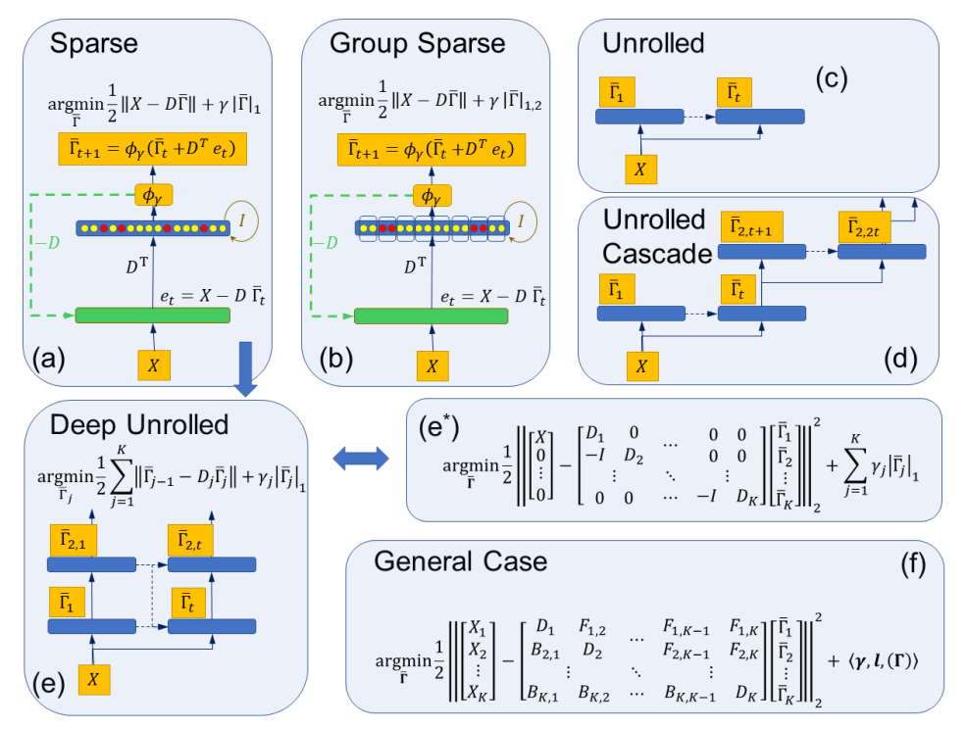
Sparse deep coding networks are robust against adversarial attacks
Features
Energy saving nets
  sparse coding
  sparse (pruned) weights
Attack can be
  corrected or
  detected
Plus
  “dictionary” is developed
    the net is capable for explanations
    translation is needed
  group sparse method is fast
Backing mathematical theorems have been developed by Dávid Szeghy for generalized architectures
2021 Conference on Mathematics of Machine Learning, Max-Planck Institute
2022 3rd International Conference on Deep Learning Theory and Applications

Slide 17
Publications July 2021 – May 2022
Published, accepted, under revision
MaCS – accepted 2021.12
  Enhancing Apparent Personality Trait Analysis with Cross-Modal Embeddings
  A Self-Supervised Method for Body Part Segmentation and Keypoint Detection of Rat Images
Acta Cybernetica – published
  Speech de-identification with deep neural networks
ICCVW workshop – published
  3D Semantic Label Transfer in Human-Robot Collaboration
arXiv – published (rejected on BMVC – improvement is under way)
  Fast Interactive Video Object Segmentation with Graph Neural Networks
PMLR – published – TDK – (Proceedings of JMLR – Q1?)
  Multimodal Sentiment and Personality Perception Under Speech: A Comparison of Transformer-based Architecture
DeLTA (3rd Int. Con. On Deep Learning Theory and Applications) – accepted
  Structural Extensions of Basis Pursuit: Guarantees on Adversarial Robustness
Journal of Imaging – published (Q2)
  Tracking Highly Similar Rat Instances under Heavy Occlusions: An Unsupervised Deep Generative Pipeline
Systems Biology and Applications – under revision (Q1)
  Peripheral gene interactions define interpretable clusters of core ASD genes in a network-based investigation of the omnigenic theory

Slide 18
Publications July 2021 – May 2022
Submitted:
  Methods of Information in Medicine (Q2-Q3)
    Handling dataset dependence with model ensembles for skin lesion classification from dermoscopic and clinical images
  MDPI Electronics (Q2)
    Soldering Data Classification with a Deep Clustering Approach: Case Study
  Healthcare Informatics Research (Q2)
    Thickness prediction of melanoma lesions
  International Conference on Multimodal Interactions (A2)
    Predicting Memorable Moments in Multi-Party Conversations
  International Conference on Multimodal Interactions (A2)
    First-Impressions in small group collaboration as a predictor of group performance
  MDPI Multimodal Technologies and Interaction (Q2-Q3)
    AI Technologies for Machine Supervision and Help in a Rehabilitation Scenario

Slide 19
Cooperations
International:
University, Research Institute
  Barcelona University: personality estimation
  Charles University: Natural Language Processing
  Delft University of Technology: group behavior estimation and prediction
  Max-Planck Institute: behavior ecology
Industrial:
  Argus Cognitive, Inc.: autism diagnostic tools
  Volkswagen Group: Ethical and Trustworthy Artificial and Machine Intelligence (ETAMI)
National:
University:
  University of Szeged (in a MiLAB project) Early diagnosis of Parkinson’s disease
  ELTE Department of Ethology: effects of environmental changes on great tits
Industrial:
  Robert Bosch, Ltd.: image processing and behavior estimation
  Martin Metals, Ltd.: MOBOT automata repository estimating warehouse robot supported by artificial intelligence using image processing methods

Slide 20
Thank you
for your
Attention!
https://nipg.inf.elte.hu/
https://iai.inf.elte.hu/
https://www.elte.hu

